Slide 1
Bank Marketing Prediction By Team Nebulans
The goal of this project is to predict if the client will subscribe a term deposit.
Team Members:
Sumangali, Pargavi, Asha, Naffila Banu, Saira Banu, Shrikumar & Ananth

Slide 2
Problem: Predicting Term Deposit Subscription
What we need to Predict?
If the client will subscribe to a term deposit
Customer’s Personal Information such as Age, Job, Marital & Education
Last contact of the current campaign
Customer’s social and economic context attributes
What we know?
Target variable y - 'yes' or 'no’
The data is related with direct marketing campaigns (phone calls) of a Portuguese banking institution.
The marketing campaigns were based on phone calls
What is the Problem?

Slide 3
Data Pre-processing
Removed Duplicates
12 duplicate records found
Impute Unknown Values
No NaN values found.
Removed Single valued columns
Default, pdays & previous columns were having only maximum single values.
Found Unknown values in most of the columns and imputed it with mode within corresponding group.
Dropped duplicates
Added Derived Features
Found a pattern in Y column when grouping by Age, Job, Marital, Education, housing & loan. Created 2 new columns

Slide 4
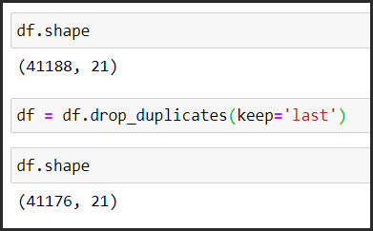
Removed Duplicates
12 duplicate records found
Dropped duplicates

Slide 5
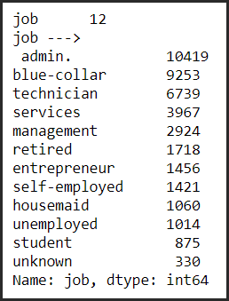
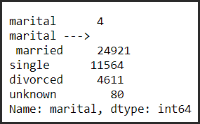
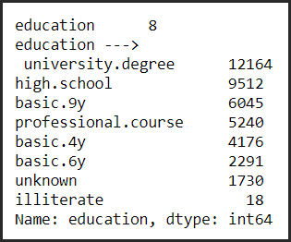
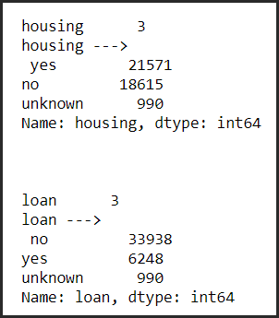
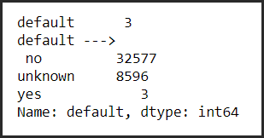
Impute Unknown Values
No NaN values found.
Found Unknown values in most of the columns and imputed it with mode within corresponding group.

Slide 6
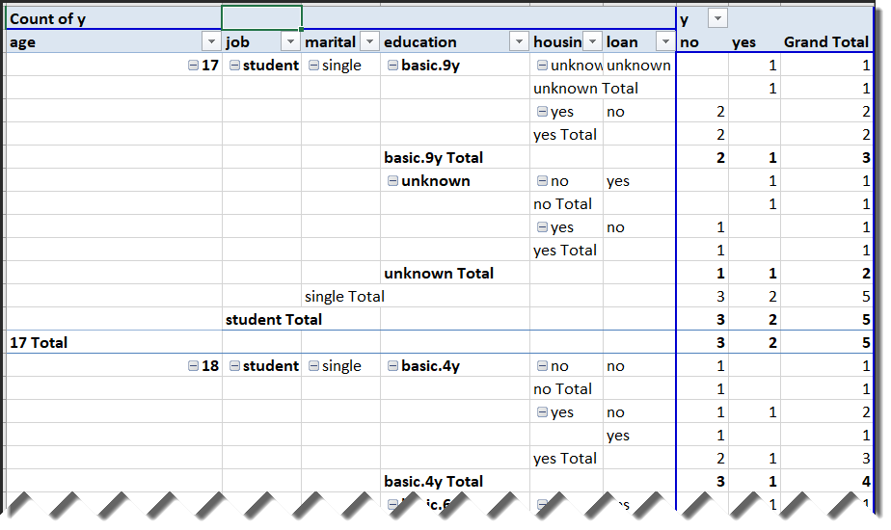
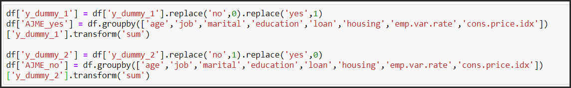
Added Derived Features
Found a pattern in Y column when grouping by Age, Job, Marital, Education, housing & loan. Created 2 new columns

Slide 7
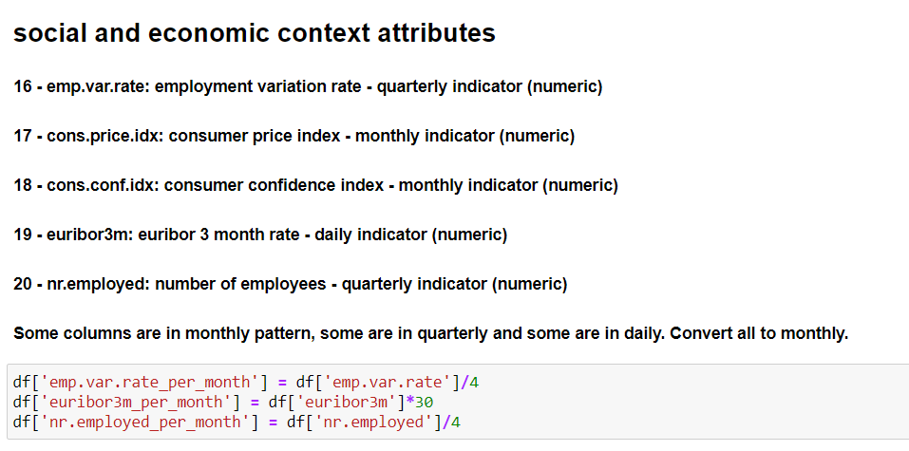
Added Derived Features
Some of the Social and economic context attributes were in daily and quarterly. Changed all the attributes to monthly.

Slide 8
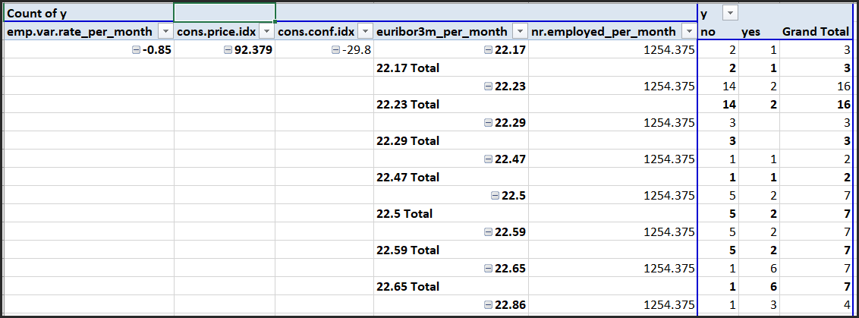
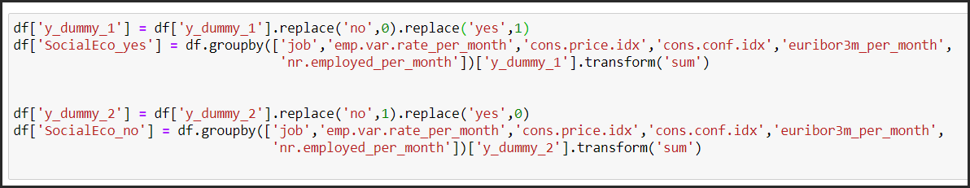
Added Derived Features
Found a pattern in Y column when grouping by Social and economic context attributes. Created 2 new columns.

Slide 9
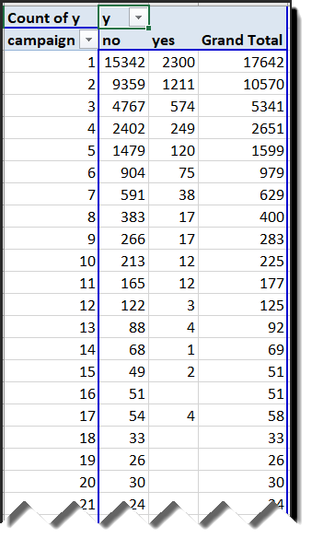
Added Derived Features
Found a pattern in Y column for Campaign variable. Created a column to use this pattern as Yes Percentage for each value in Campaign.
Yes Value counts are decreasing for higher values of Campaign and turns almost zero after 16. Which may imply a percentage of Yes values in target column. Created a new column for this

Slide 10
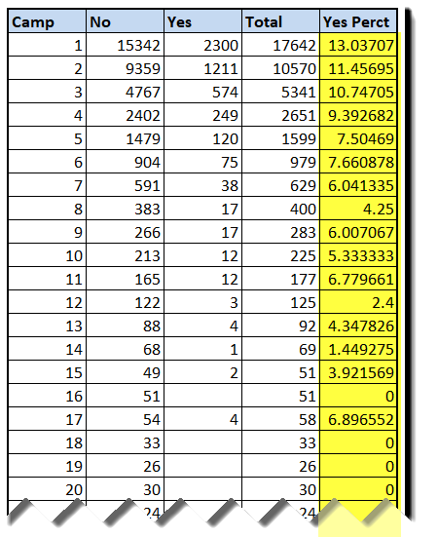
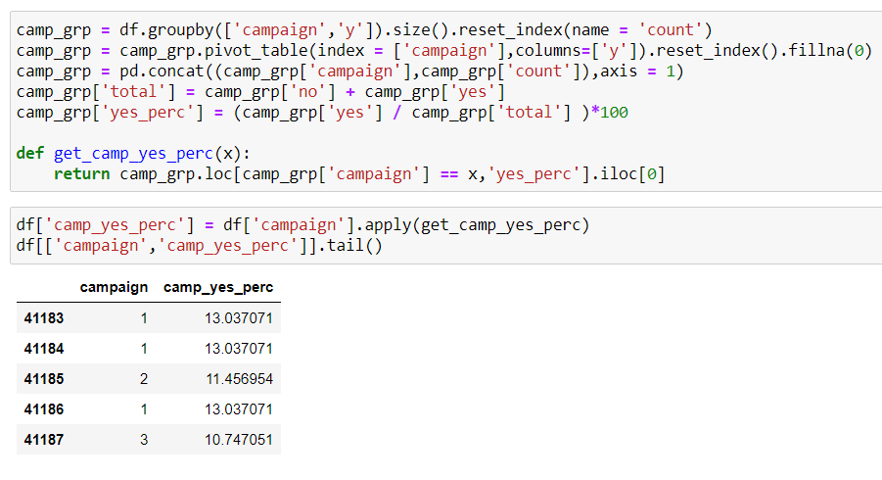
Added Derived Features
Found a pattern in Y column for Campaign variable. Created a column to use this pattern as Yes Percentage for each value in Campaign.

Slide 11

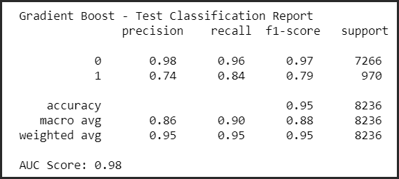
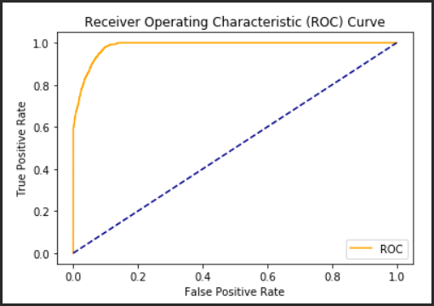
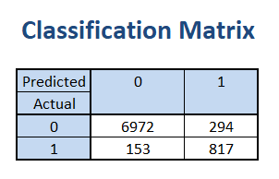
Model #1: Using Gradient Boost Algorithm
This model provides good accuracy of 94.6% and Predicts 817 TPs (Target - Yes) out of 1,111 total Positive results.
If the client is ready to spend money and efforts on 1,111 customers then they will get 817 customers who will subscribe for Term Deposits approximately.

Slide 12

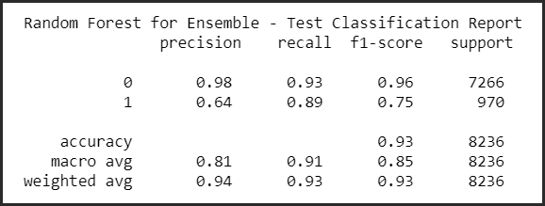
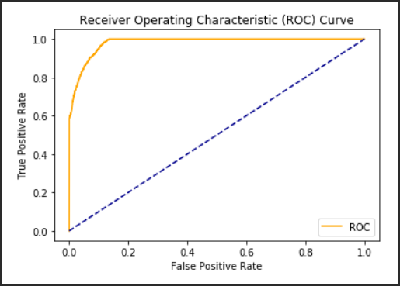
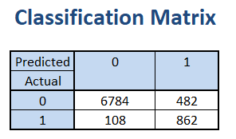
Model #2: Using Random Forest Ensemble
This model provides good accuracy of 92.8% and Predicts 862 TPs (Target - Yes) out of 1,344 total Positive results.
If the client is ready to spend money and efforts on 1,344 customers then they will get 862 customers who will subscribe for Term Deposits approximately.

Slide 13

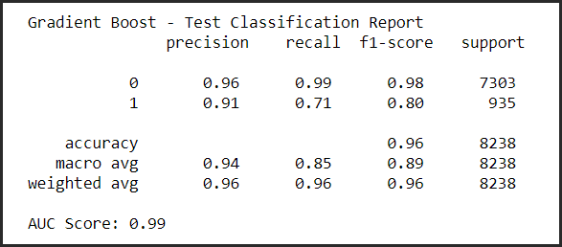
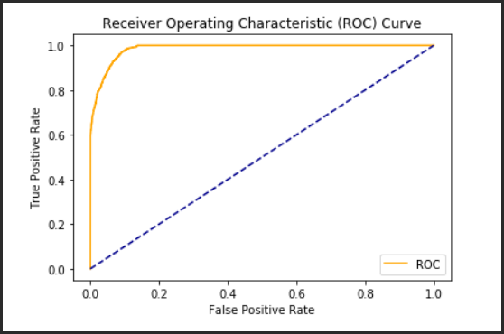
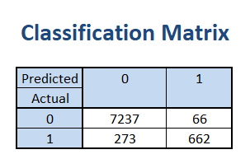
Model #3: Using Gradient Boosting Algorithm
This model gives the best accuracy out of all the 3 models, of 95.9% but Predicts 2 TPs (Target - Yes) out of 728 total Positive results.
If the client do not need to speed more money on customers who is not really going to subscribe for the term deposits and they do not have a high budget for this campaign then they can choose this model.

Slide 14
Comparisons of Models 1, 2 & 3
Properties | Model #1 | Model #2 | Model #3
Algorithm Used | Gradient Boosting | Random Forest Ensemble | Gradient Boosting
Accuracy | 94.6 | 92.8 | 95.9
Precision/recall/f1 score of getting Subscription | 0.74/0.84/0.79 | 0.64/0.89/0.75 | 0.91/0.71/0.80
Unknown data imputation done? | Yes | Yes | No
SMOTE Applied? | Yes | Yes | No
Added Derived Features? | Yes | Yes | Yes

Slide 15
Conclusion
Out of all the above 3 models we would suggest to go with the Model #3 where no Unknown imputation or SMOTE transformations needed.
This model gives the highest Precision, Recall & F1 score out of all the 3 models.
So our final Model’s
Accuracy: 95.9
Precision/recall/f1 score of getting Subscription: 0.91/0.71/0.80

